Slide 1

Go, change the world
RV College of Engineering
CAEG(21ME16/26)
Computer Aided Engineering Graphics (Solutions)
Dr. N V N Aradhya
Professor,
Department of Mechanical Engineering,
RV College of Engineering
Bangaluru-560059
Mobile: 9448180450 Email:nanjundaradhya@rvce₁.edu.in

Slide 2
Projections of Points
RV College of
Engineering

Slide 3
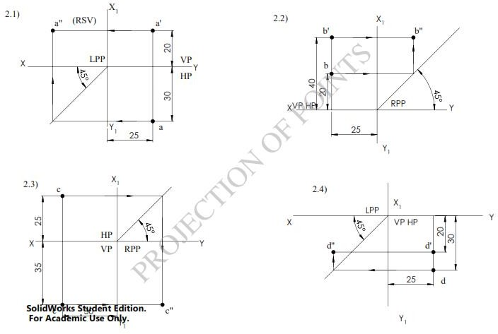
RV College of
Engineering
Projections of Points

Slide 4
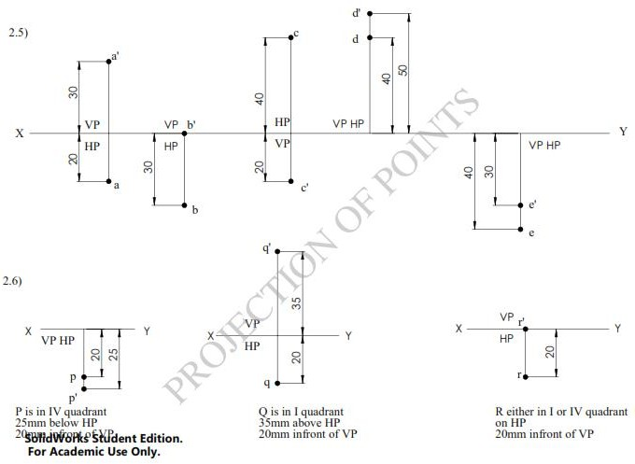
RV College of
Engineering
Projections of Points

Slide 5
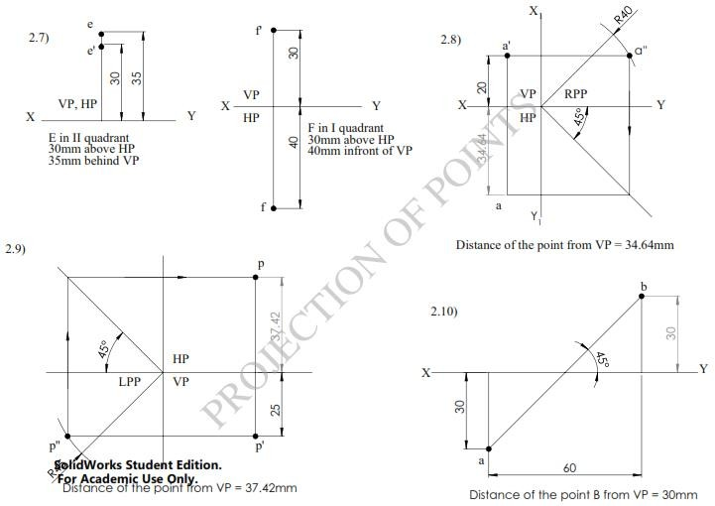
RV College of
Engineering
Projections of Points

Slide 6
Projections of Straight Lines
RV College of
Engineering

Slide 7
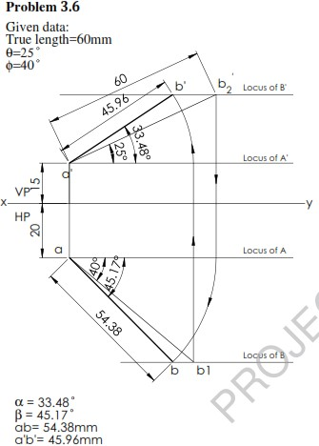
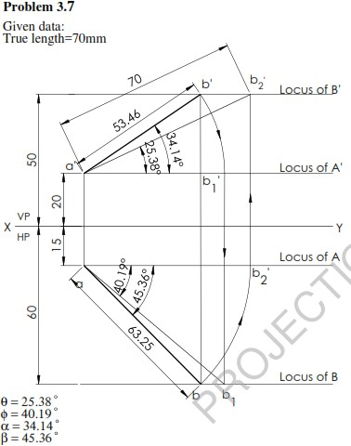
Projections of Straight Lines
RV College of
Engineering

Slide 8
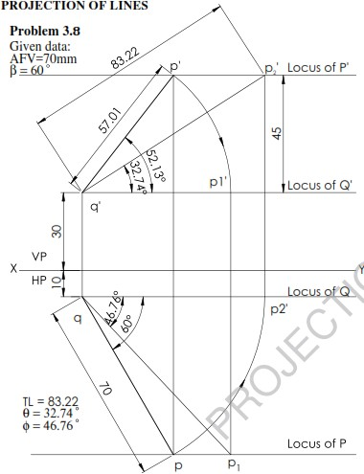
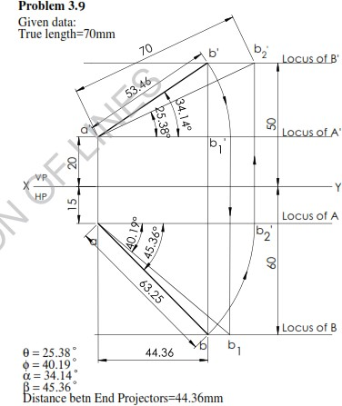
Projections of Straight Lines.
RV College of
Engineering

Slide 9
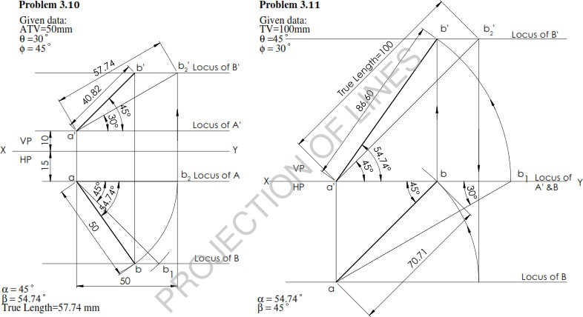
RV College of
Engineering
Projections of Straight Lines.

Slide 10
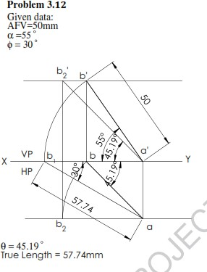
Projections of Straight Lines.
RV College of
Engineering

Slide 11
Projections of Planes
RV College of
Engineering

Slide 12
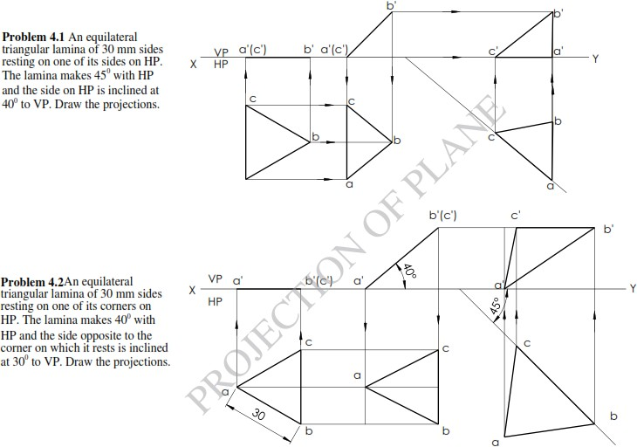
RV College of
Engineering
Projections of Planes

Slide 13
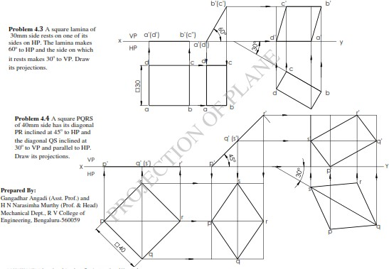
RV College of
Engineering
Projections of Planes

Slide 14
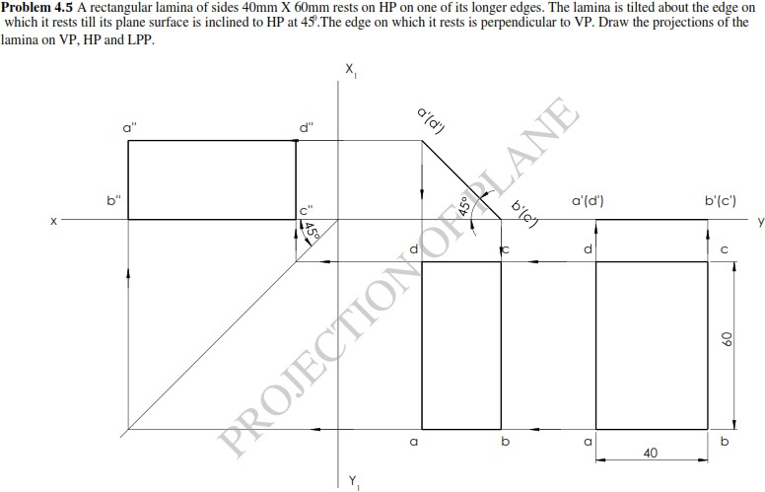
RV College of
Engineering
Projections of Planes

Slide 15
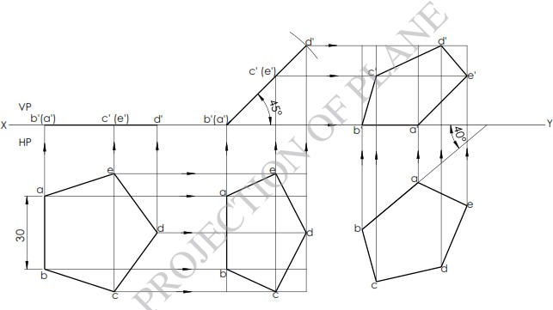
Projections of Planes
RV College of
Engineering
Problem 4.6

Slide 16
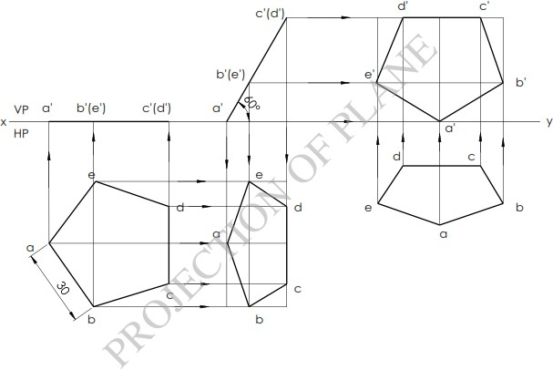
Projections of Planes
RV College of
Engineering

Slide 17
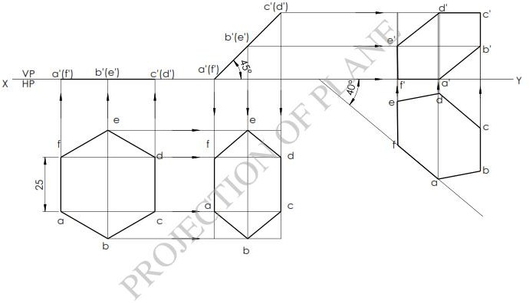
Projections of Planes
RV College of
Engineering

Slide 18
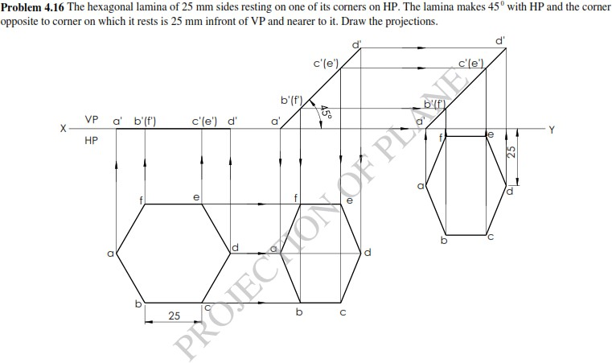
Projections of Planes
RV College of
Engineering
Problem 4.9

Slide 19
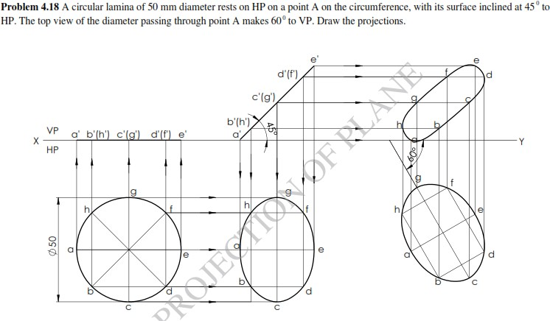
Projections of Planes
RV College of
Engineering
Problem 4.10

Slide 20
Projections of Solids
RV College of
Engineering

Slide 21
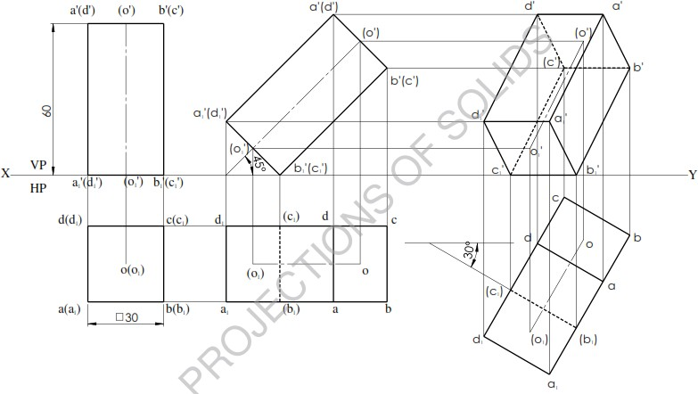
RV College of
Engineering
Projections of Solids
Problem 5.1: A square prism of base sides 30 mm and 60 mm axis length rests on HP on one of its base edges which is inclined at 30⁰ to VP. Draw its projections when the axis is inclined at 45⁰ to HP.

Slide 22
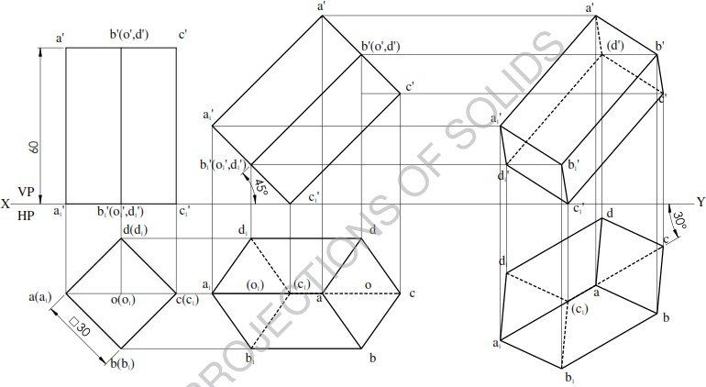
RV College of
Engineering
Projections of Solids
Problem 5.2: A square prism of base sides 30 mm and 60 mm axis length rests on HP on one of its base corners in such a way that the axis is inclined at 45⁰ to HP. Draw its projections when the axis is inclined at 30⁰ to VP.

Slide 23
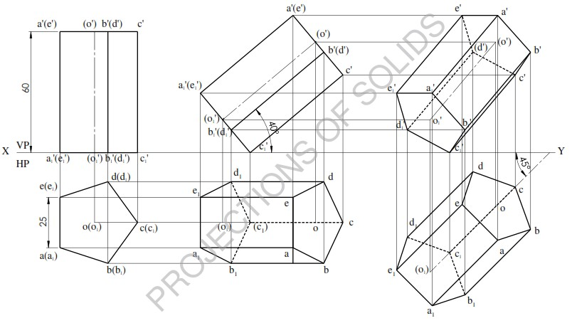
Projections of Solids
RV College of
Engineering
Problem 5.3: A pentagonal prism of base sides 25mm and 60mm axis length rests on HP on one of its base corners such that the two base edges containing the corner on which it rests make equal inclinations with HP. Draw the projections when the axis is inclined at 40⁰ to HP and appears to be inclined at 45⁰ to XY line.

Slide 24
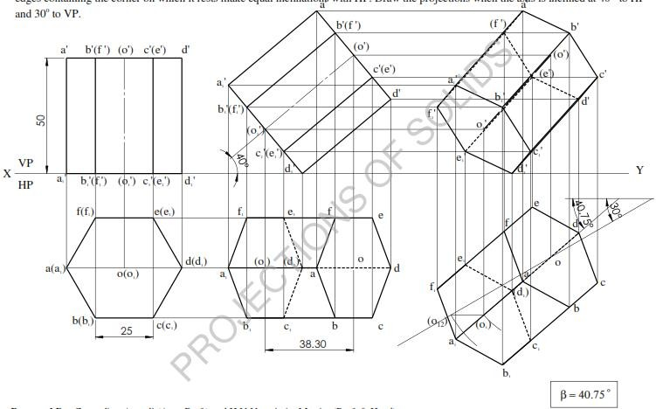
Projections of Solids
RV College of
Engineering
Problem 5.5: A hexagonal prism of base sides 25mm and 50mm axis length rests on HP on one of its base corners such that the two base edges containing the corner on which it rests make equal inclinations with HP. Draw the projections when the axis is inclined at 40⁰ to HP and 30⁰ to VP.

Slide 25
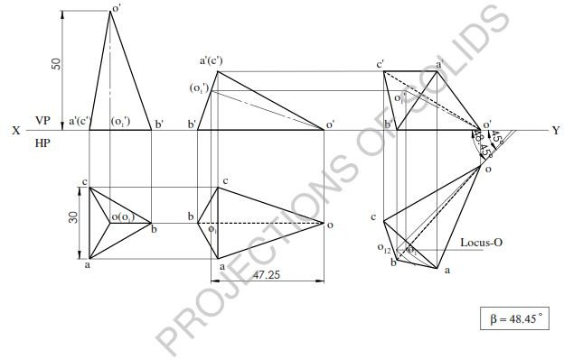
Projections of Solids
RV College of
Engineering
Problem 5.6: A triangular pyramid 30 mm base edges and 50 mm axis length rests on HP on one
of its slant edges. Draw the projection of the pyramid when the axis is inclined to VP at 45⁰.

Slide 26
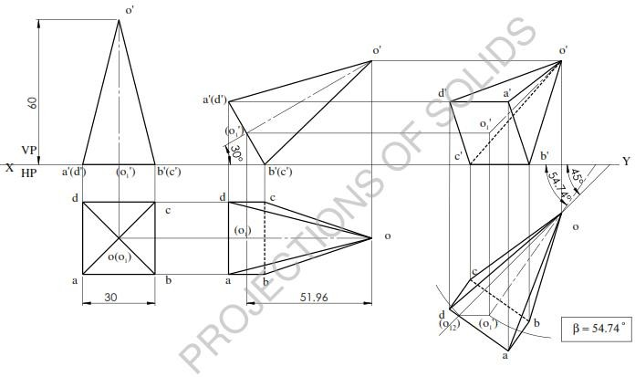
RV College of
Engineering
Projections of Solids
Problem 5.7: A square pyramid 30 mm base edge and 60 mm axis length rests on HP on one of its base edges. Draw the projection of the pyramid when the axis is inclined at 30⁰ to HP and 45⁰ to VP.

Slide 27
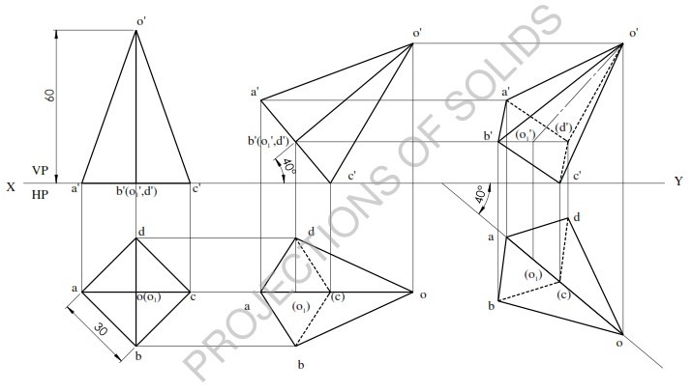
Projections of Solids
RV College of
Engineering
Problem 5.8: A square pyramid 30 mm base edge and 60 mm axis length rests on HP on one of its base corners such that the two base edges containing the corner on which it rests make equal inclinations with HP. Draw the projections when the axis is inclined at 45⁰ HP and top view of the axis makes 40⁰ to XY line when the apex is nearer to the observer.

Slide 28
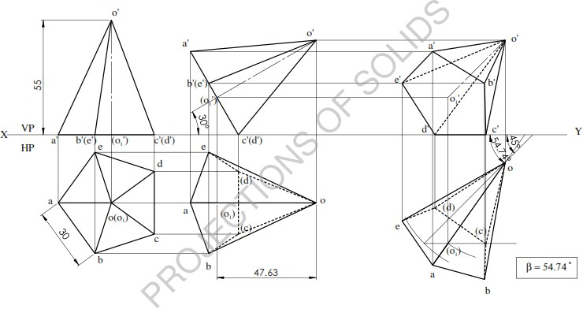
RV College of
Engineering
Projections of Solids
Problem 5.9: A pentagonal pyramid 30 mm base edges and 55 mm axis length rests on HP on one of its base edges. Draw the projections of the pyramid when the axis is inclined at 30⁰ to HP and 45⁰ to VP.

Slide 29
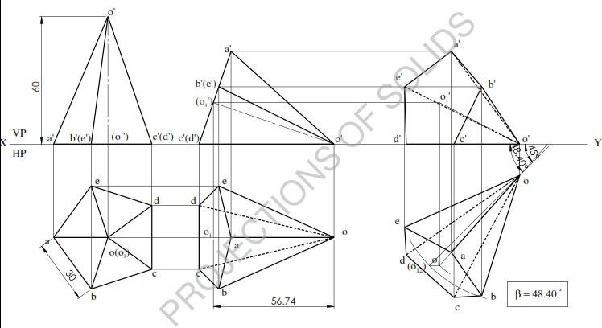
RV College of
Engineering
Projections of Solids
Problem 5.10: A pentagonal pyramid 30 mm base edges and 60 mm axis length rests on HP on one of its triangular faces. Draw the projections of the pyramid when the axis is inclined to VP at 45⁰ and the base is nearer to the observer.

Slide 30
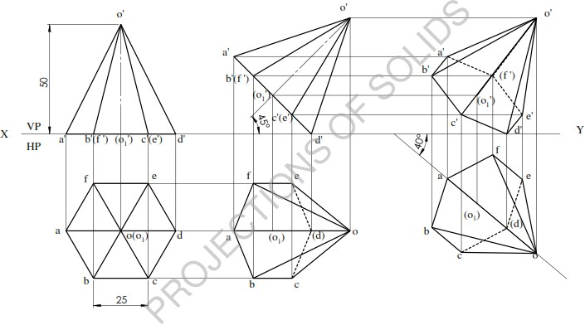
Projections of Solids
RV College of
Engineering
Problem 5.11: A hexagonal pyramid of base edge 25 mm and height 50 mm rests on HP on one of its base corners such that the two base edges containing the corner on which it rests make equal inclinations with HP. Draw the projections when the axis is inclined at 45⁰ to HP and top view of the axis makes 40⁰ to XY line when the apex is nearer to the observer.

Slide 31
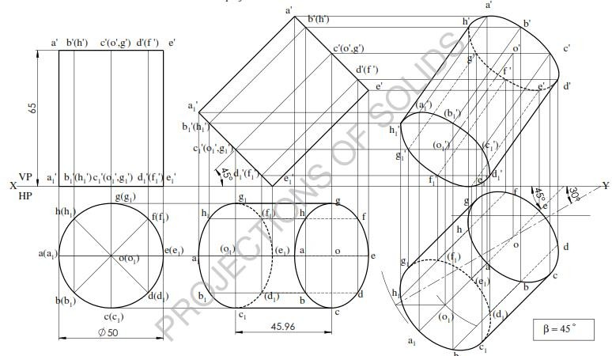
RV College of
Engineering
Projections of Solids
Problem 5.12: A cylinder of base circle diameter of 50 mm and 65 mm axis length rests on HP on one of its base point on HP with its axis inclined at 45⁰ to HP and 30⁰ to VP. Draw the projections.

Slide 32
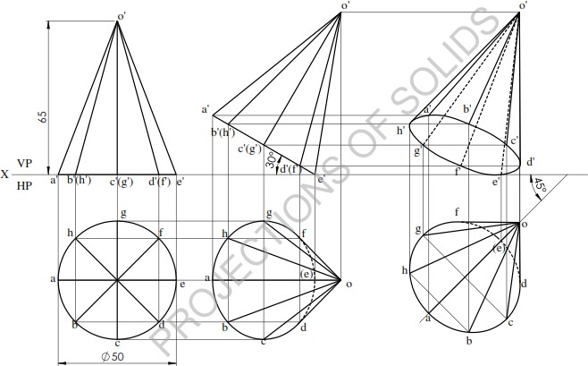
RV College of
Engineering
Projections of Solids
Problem 5.14: A cone of base circle diameter of 50 mm and 65 mm axis length is resting on a base point on HP. Base makes 30⁰ to HP. Draw the projection of the cone when the axis appears to be inclined at 45⁰ to VP.

Slide 33
Isometric Projection
RV College of
Engineering

Slide 34
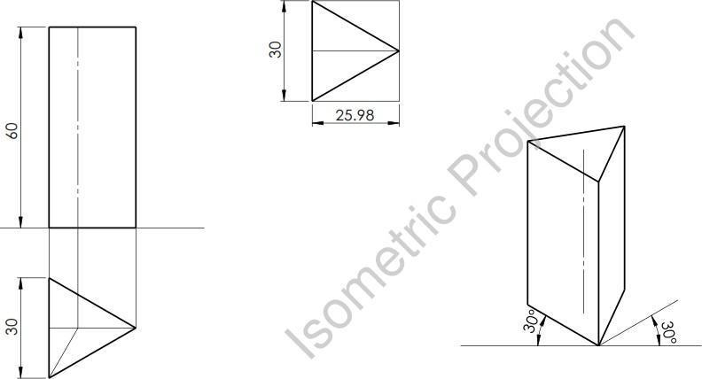
Isometric Projection
RV College of
Engineering
Problem 6.1: Draw the isometric projections of triangular prism of side of base 30 mm, axis 60
mm long. The prism is resting on its base on HP and an edge of base perpendicular to VP.

Slide 35
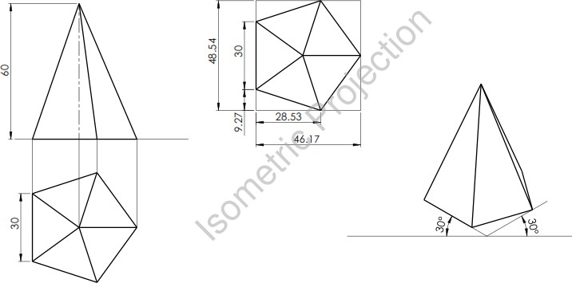
Isometric Projection
RV College of
Engineering
Problem 6.2: A pentagonal pyramid of base side 30 mm and axis length 60 mm is resting on HP
on its base with a side of base perpendicular to VP. Draw its isometric projections.

Slide 36
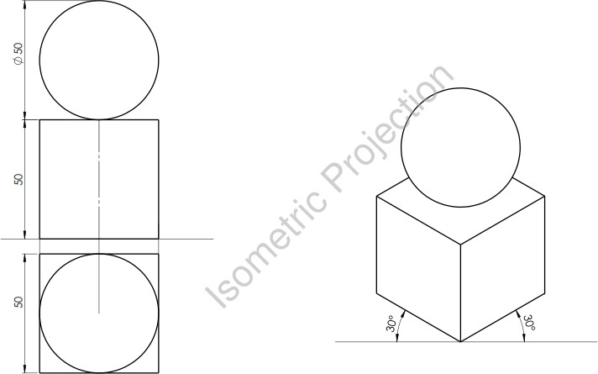
Isometric Projection
RV College of
Engineering
Problem 6.3: A sphere of diameter 50 mm rests centrally on top of a cube of sides 50 mm. Draw
the isometric projections of the combination of solids.

Slide 37
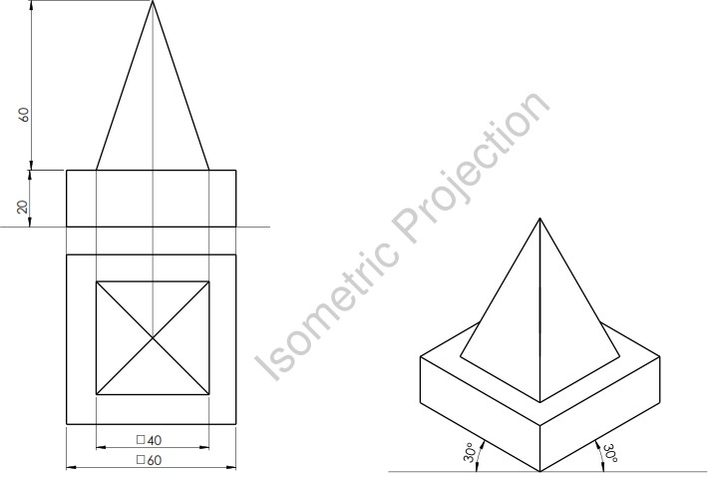
RV College of
Engineering
Isometric Projection
Problem 6.4: A square pyramid 40 mm side and height 60 mm rests on the center of the top of a square block of side 60 mm and height 20 mm. The base edge of the pyramid is parallel to the top edge of the square block. Draw the isometric projection of the combination of the solids.

Slide 38
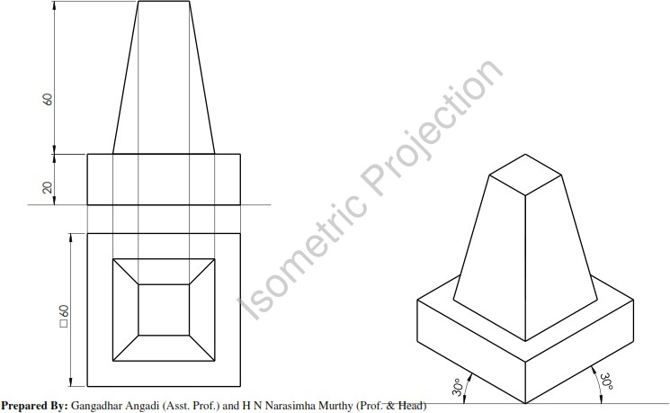
Isometric Projection
RV College of
Engineering
Problem 6.5: The frustum of a square pyramid of sides of top face 20 mm, bottom face 40 mm and height 60 mm rests centrally on top of a square block of side 60 mm and height 20 mm. The base edges of the pyramid are parallel to the top edges of the square block. Draw the isometric projection of combination of solids.

Slide 39
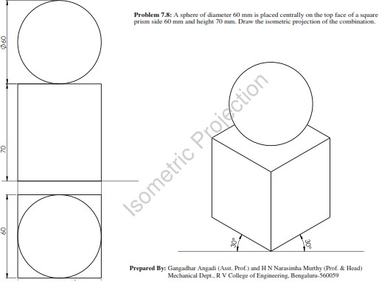
Isometric Projection
RV College of
Engineering
Problem 6.6: A sphere of diameter 60 mm is placed centrally on the top face of a square prism
side 60 mm and height 70 mm. Draw the isometric projection of the combination.

Slide 40
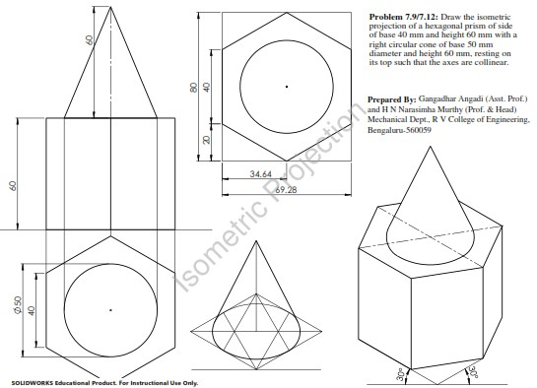
RV College of
Engineering
Isometric Projection
Problem 6.7/6.8: Draw the isometric projection of a hexagonal prism of side of base 40 mm and height 60 mm with a right circular cone of base 50 mm diameter and height 60 mm, resting on its top such that the axes are collinear.

Slide 41
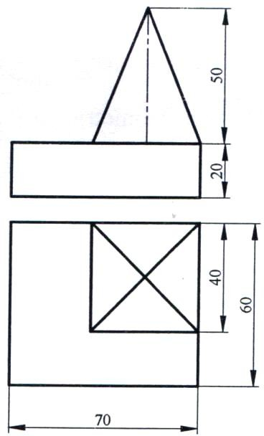
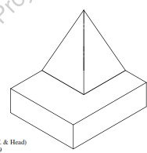
RV College of
Engineering
Isometric Projection
Problem 6.9: Draw the isometric projection of the combination of solids shown in fig.

Slide 42
Development of surfaces
RV College of
Engineering

Slide 43
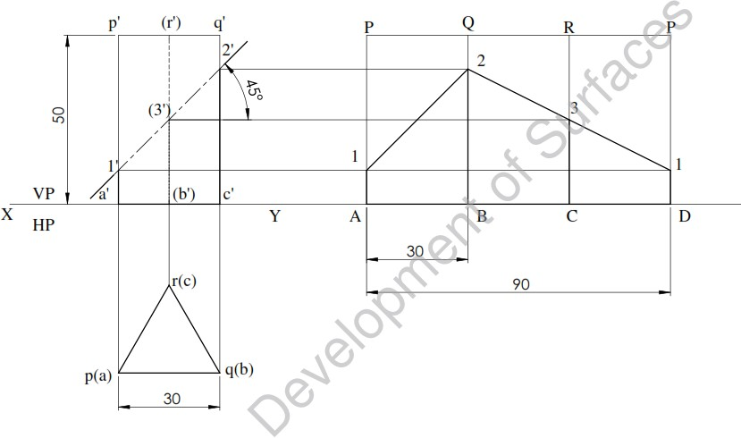
Development of surfaces
RV College of
Engineering
Problem 10.1: A triangular prism of base edge 30 mm and height 50 mm rests on HP with its axis vertical and a base edge parallel to VP and farther from it. A section plane perpendicular to VP and inclined at 45⁰ to HP bisects the axis of the prism. Draw the development of lateral surface of retained portion of the solid.

Slide 44
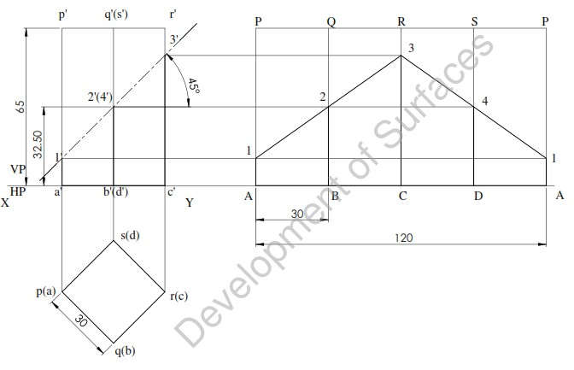
Development of surfaces
RV College of
Engineering
Problem 10.2: A square prism of 30mm base edges and 65 mm axis length rests on HP with its
axis vertical and two of its lateral surfaces are equally perpendicular to VP and inclined at 45⁰ to HP bisects development of lateral surface of retained portion of the solid.
inclined to VP. A section
plane
the axis of the prism. Draw the

Slide 45
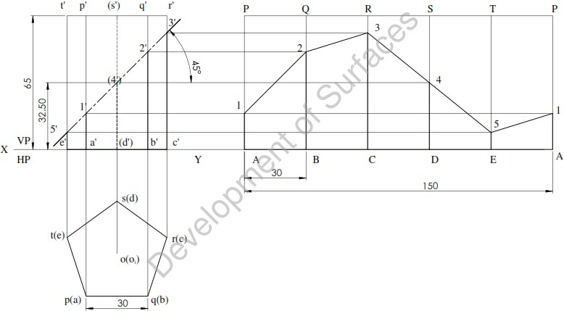
Development of surfaces
RV College of
Engineering
Problem 10.3: A pentagonal prism of 30mm base edges and 65 mm axis length rests on HP with two of its lateral surfaces are equally inclined to VP and nearer to it. A section plane perpendicular to VP and inclined at 45⁰ to HP bisects the axis of the prism. Draw the development of lateral surface of retained portion of the solid.

Slide 46
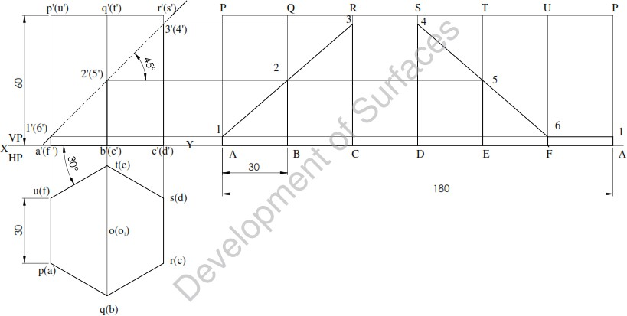
Development of surfaces
RV College of
Engineering
Problem 10.4: A hexagonal prism of 30mm base edges and 60 mm axis length rests on HP with its axis vertical and one of its lateral surfaces is inclined at 30⁰ to VP and nearer to it. A section plane perpendicular to VP and inclined at 45⁰ to HP bisects the axis of the prism. Draw the development of lateral surface of retained portion of the solid.

Slide 47
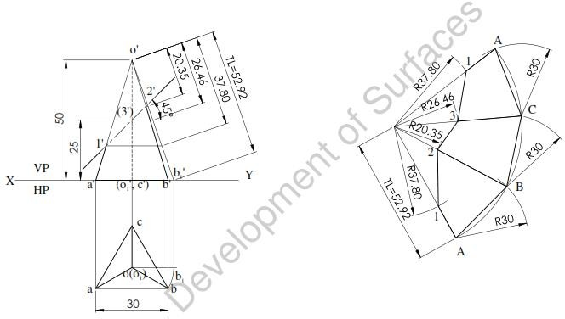
Development of surfaces
RV College of
Engineering
Problem 10.5: A triangular pyramid of base edge 30 mm and height 50 mm rests on HP with its axis vertical and two of its base edges equally inclined to VP and nearer to it. A section plane perpendicular to VP and inclined at 45⁰ to HP bisects the axis of the pyramid. Draw the development of lateral surface of retained portion of the solid.

Slide 48
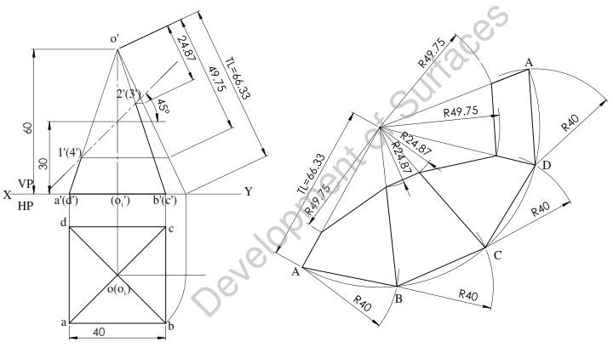
Development of surfaces
RV College of
Engineering
Problem 10.6: A square pyramid of base edge 40 mm and height 60 mm rests on HP with its axis vertical and two of its base edges parallel to VP. A section plane perpendicular to VP and inclined at 45⁰ to HP bisects the axis of the pyramid. Draw the development of lateral surface of retained portion of the solid.

Slide 49
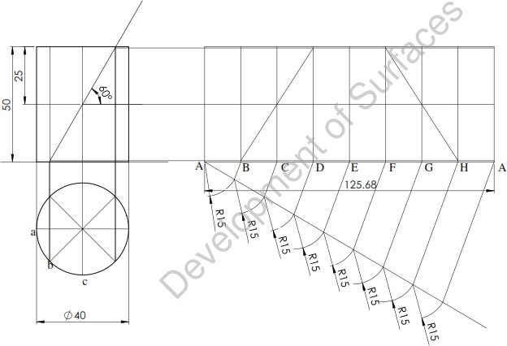
RV College of
Engineering
Development of surfaces
Problem 10.7: Draw the development of the lateral surface of a truncated cylinder, 40 mm diameter of base and height 50 mm, if the truncated flat surface of the cylinder bisects the axis at 60⁰ to it.

Slide 50
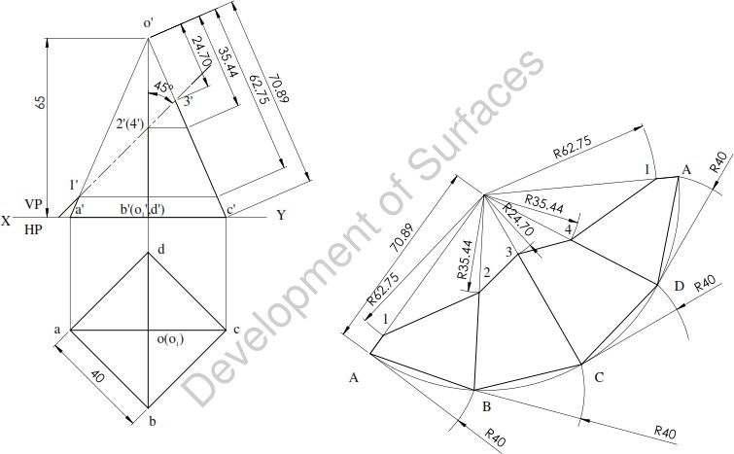
Development of surfaces
RV College of
Engineering
Problem 10.8: A square pyramid side of base 40 mm and axis 65 mm long has its base on HP and all the edges of the base are equally inclined to VP. It is cut with an inclined section plane so that the truncated surface is at 45⁰ to the axis bisecting it. Draw the development of the truncated pyramid.

Slide 51
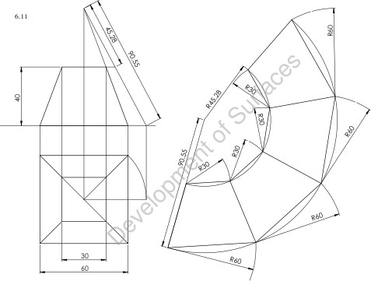
RV College of
Engineering
Development of surfaces
Problem 10.9: The frustum of a square pyramid has is base 60 mm sides, top face 30 mm and height 40 mm. Its axis is vertical and a side of base is parallel to VP. Draw the development of lateral surfaces.

Slide 52
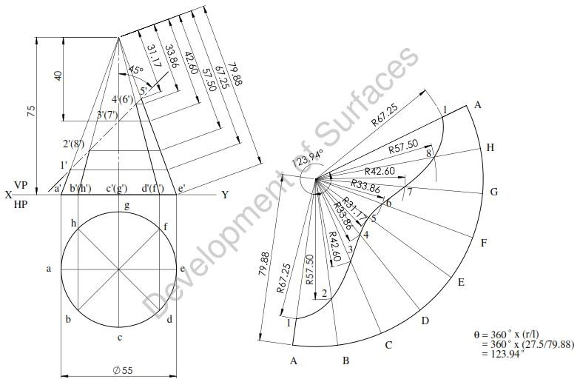
RV College of
Engineering
Development of surfaces
Problem 10.10: A right cone of 55 mm base diameter and 75 mm height stands on its base on HP. It is truncated with its surface inclined at 45⁰ to the axis lying at a distance of 40 mm from the apex of the cone. Obtain the development of the lateral surface of the truncated cone.

Slide 53
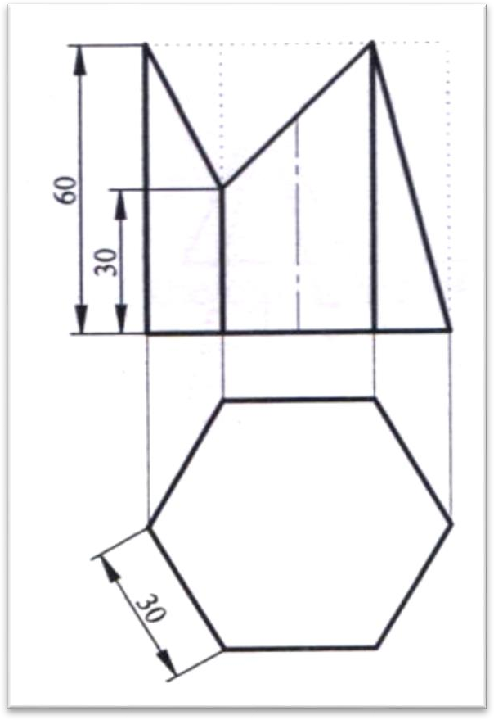
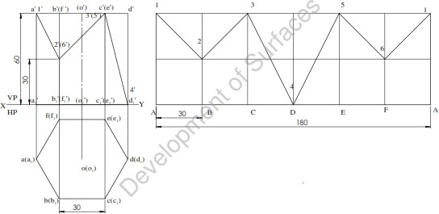
Development of surfaces
RV College of
Engineering
Problem 10.11: A hexagonal prism side of base 30mm and height 60mm is cut as shown in the
fig. Draw the development of the lateral surface of the prism.

Slide 54


RV College of
Engineering
Development of surfaces
Problem 10.12: Draw the development of the lateral surface of the pyramid shown in fig.

Slide 55


RV College of
Engineering

